Slide 1

COMPANY & PRODUCT - OVERVIEW
Expert of Smart Factory Solution
Expert of Smart Factory Solutions & Industry 4.0

Slide 2


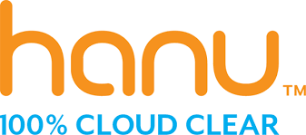


See Global International-Overview
See Global International-Overview
Hands on Knowledge in Manufacturing Business
Expert of Industry 4.0 and Advance Digitalization
Expert on Cyber Security, Total Wieless and Cloud Migration
450 Years of Combined Years
Leader in Plant / Factory Automation
Partnering with Advance Digital Technologies
Leaders are Industry Experts
Mission: Help Organization to Improve Overall Plant Effectviness ( OPE) & Increase Competitve Advantage
See Global International-Overview
Vibration, Sound, Piezo Electric, Proximeter REED, Infrared, Temperature, Barometer, Speed
Gas Sensor,Moisture, Humidity, PH; Energy Meter, Current, voltag, etc.
Overall Plant Effectviness & Competitve Advantage
Enterprise Solution
Manufacturing Excellence
Production Excellence
Quality Excellence
Safety Excellence
IoT
IIoT
Edge Computing
Totaly wireless Cloud Migration
Big Data Analytics
AI & ML ( Artificial Intelligence)
IIoT
PLC,DCS, SCADA
Video, RF Tag, BLE; Track & Trace, Asset Tacking Raw Material, Inventory , Manpower, etc
Technology Partners

Slide 3

See Global – Value Proposition
Leaders
Capability
Experienced Industry Managers who know the business challenges, Competition and requirement of delivering sustainable solutions.
Team from USA, SWEDEN , INDIA & Central Europe
900⁺ web Certified Cloud migration Engineers
The Analytics team head holding a Phd in information theory and having many IP rights in his name.
Leaders from upstream Oil and Gas, Oil Refinery, Petrochemical, Chemical, Metals, Fibres, Power, Automobile, Business consultancy, Financial Institution .
The Business Leaders are MBA , Engineers & CA from top Institution.
Focus of team mainly on OT Solutions – Combination OT & IT Technology in single platform
Leaders having experience in more than 15 Countries, Including India, SEA, GULF, Romania, South America, Europe & USA .
Structure
Leaders combined experiences are more then 450 Years
Consortium Organization provide end to end digital solution to Industries.

Slide 4

See Global International-Overview
See Global International-Organization Structure
Project Management / Solution Team
Client
IOT /IIOT Solution Team
Cloud Computing/ Cloud Solution Team
BIG Data/ Analytics Solution Team
Dash Board/ Chat Bot Solution
Specialised at AWS
SAS Solution
Specialised at Azure (Microsoft)
SAS Solution

Slide 5
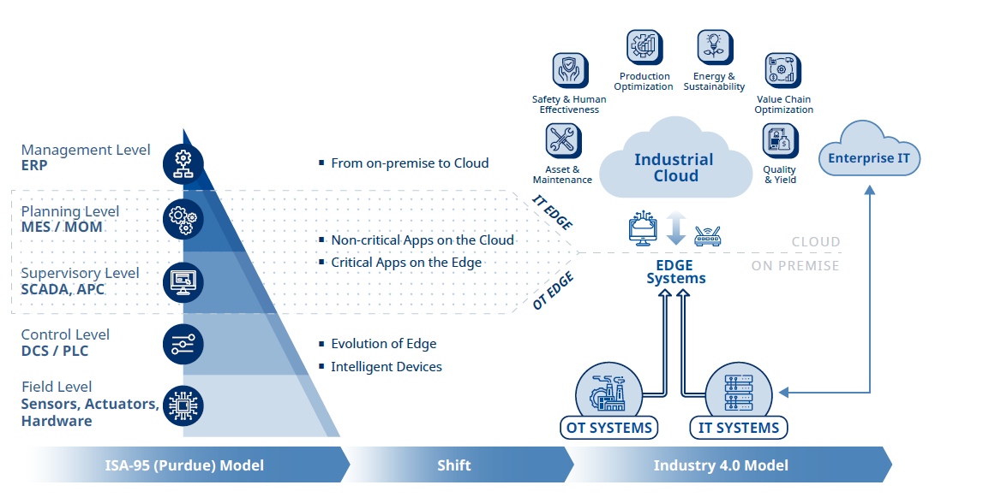
Products, Services & Application of Industry 4.0

Slide 6
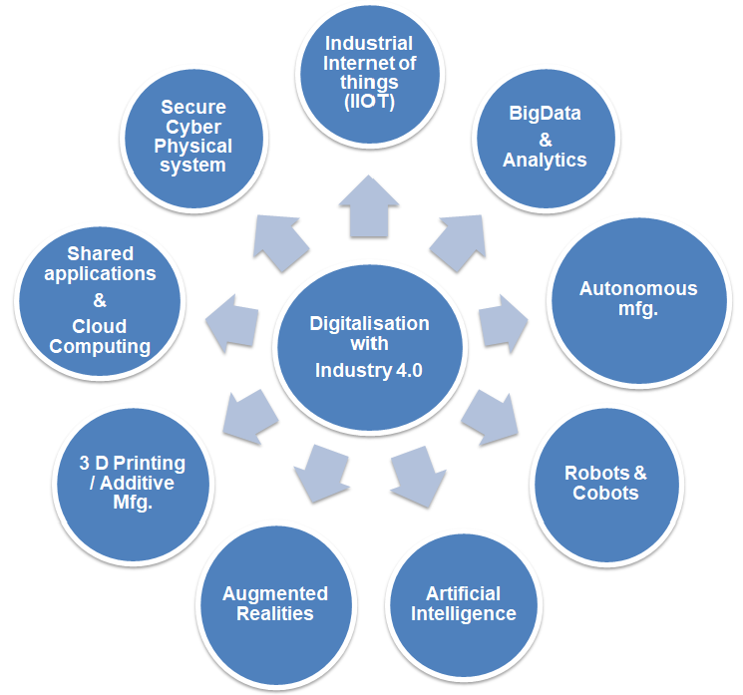
“9” pillars model of Industry 4.0
1
We will provide end-to-end turnkey value driven solutions for manufacturing industries with advance Technology & solutions
Consulting & blueprinting
Scope definition
Design & Detailed Engineering
Application Delivery on IIoT Platforms
Cloud or On premises architecture
Complete Project Management
Installation / Erection & Commissioning
On Site Training & Technical Assistance
9
2
8
3
7
4
6
5

Slide 7
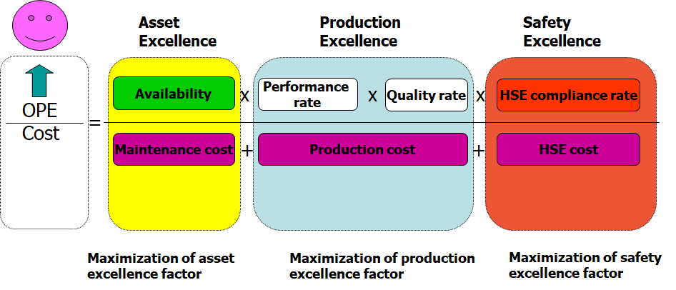
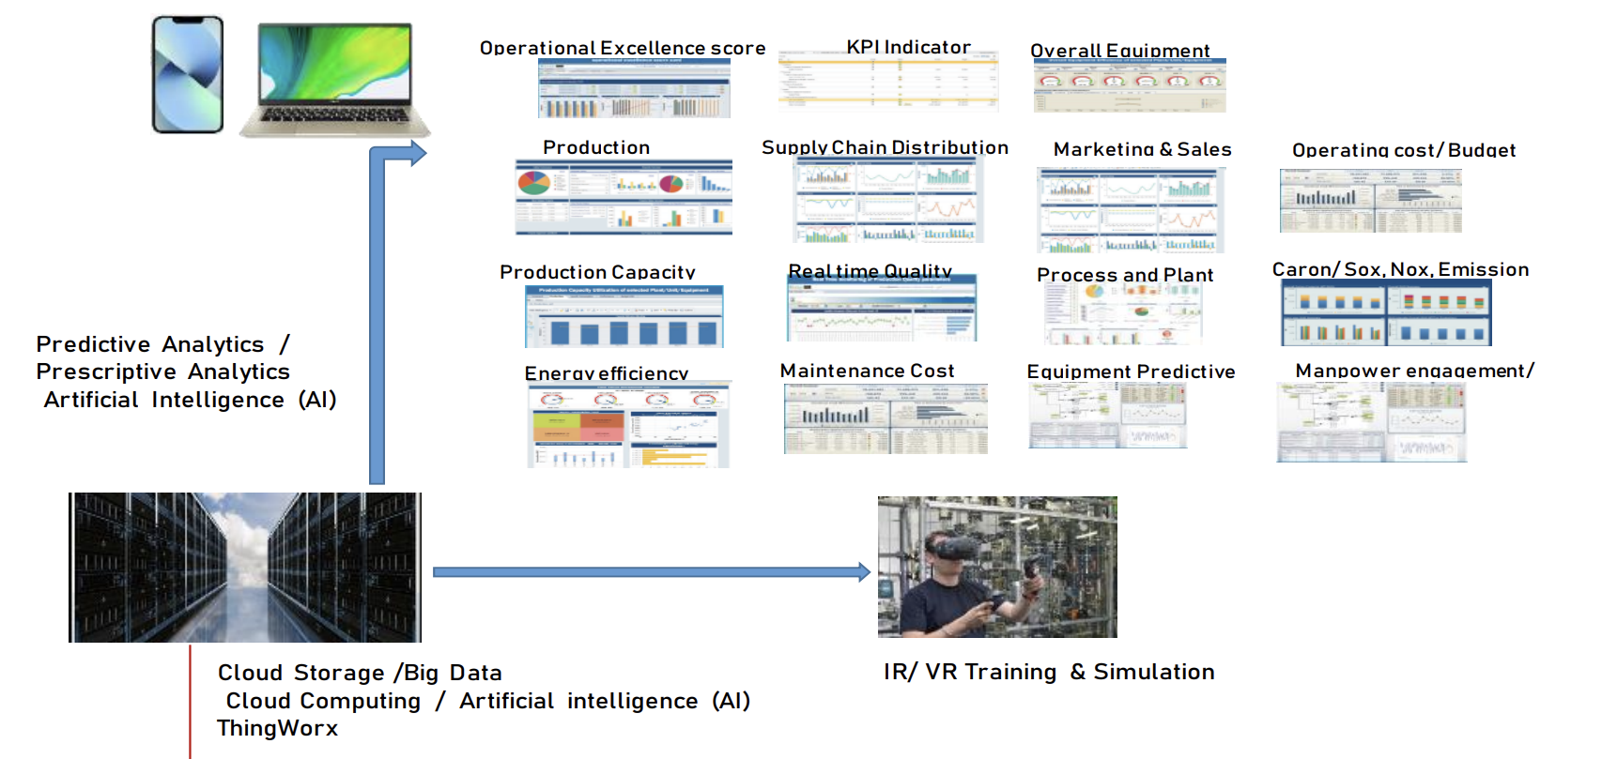
See Global International-Services
Digital Audit & Gap Analysis
Business Case Analysis
Consulting & Scope Definition
Design & Detailed Engineering
Complete Project Management
Installation / Erection & Commissioning
On Site Training & Technical Assistance
IoT, IIoT , Design Section, Installation
Application Delivery on IIoT Platforms
Plant System Integration ( PLC,DCS,SCADA) & SAP with IoT, IIoT
Cloud or On premises architecture
Cloud Migration and SaaS Solution
Big Data Analytics, AI, ML, Management Report
Prescription & Predictive Analytics

Slide 8
See Global – Architecture of Smart Factory Solution / Industry 4.0

Slide 9
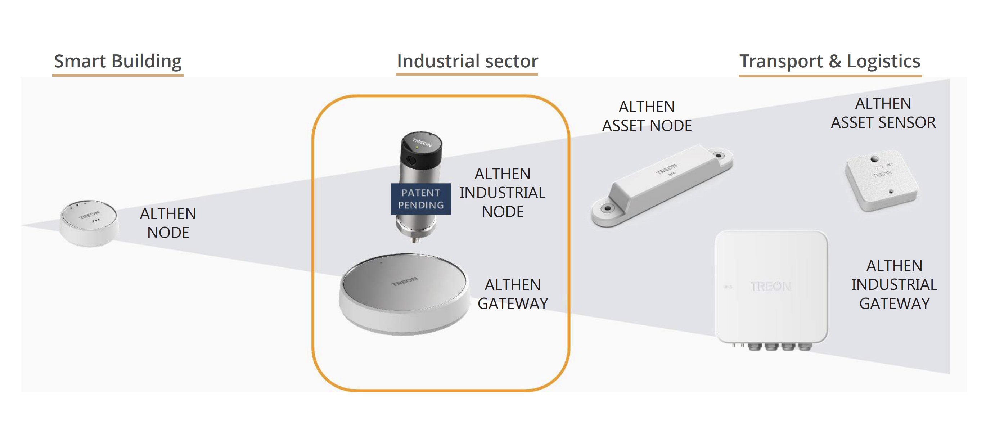

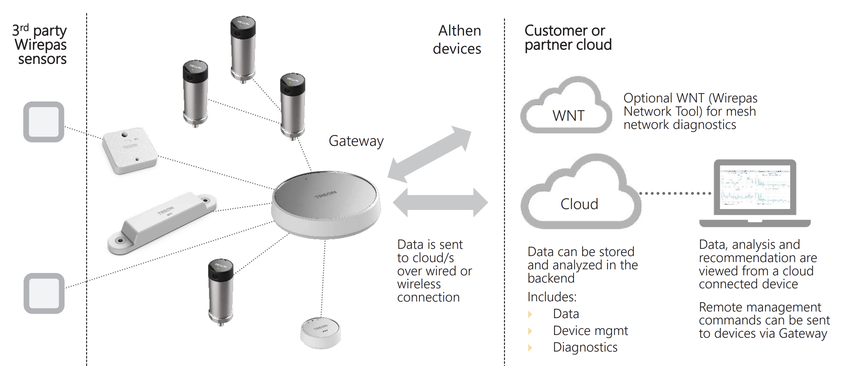
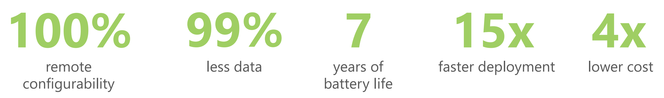
See Global – IoT Sensors, Node, Gateway

Slide 10
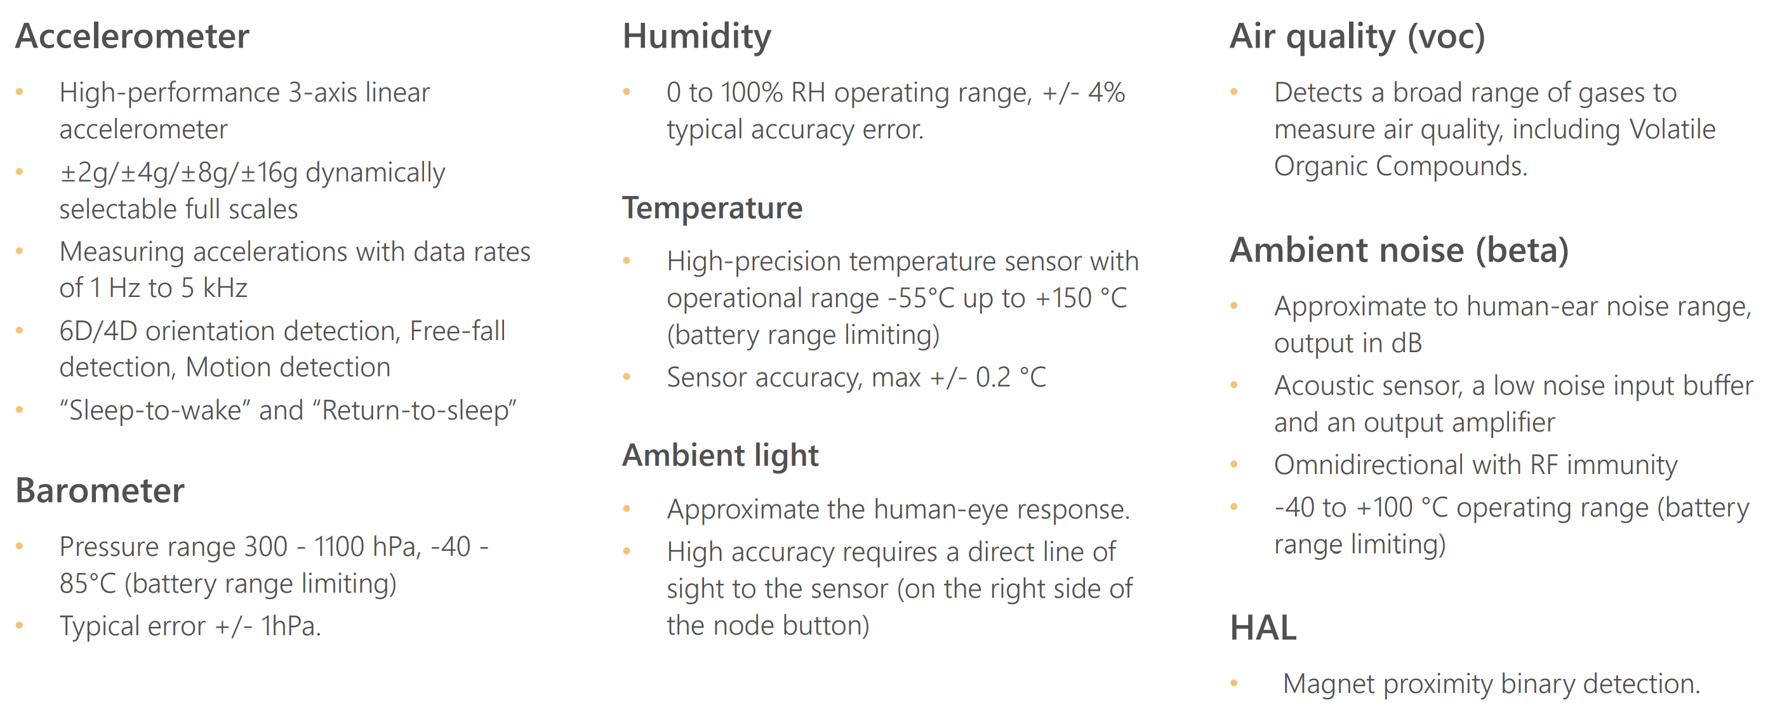
See Global – IoT Node Sensors

Slide 11
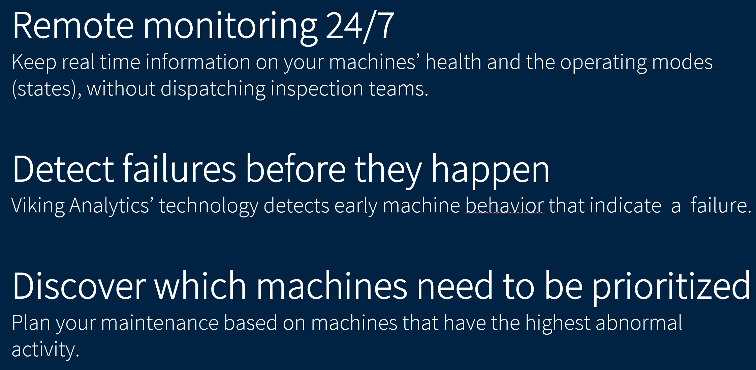


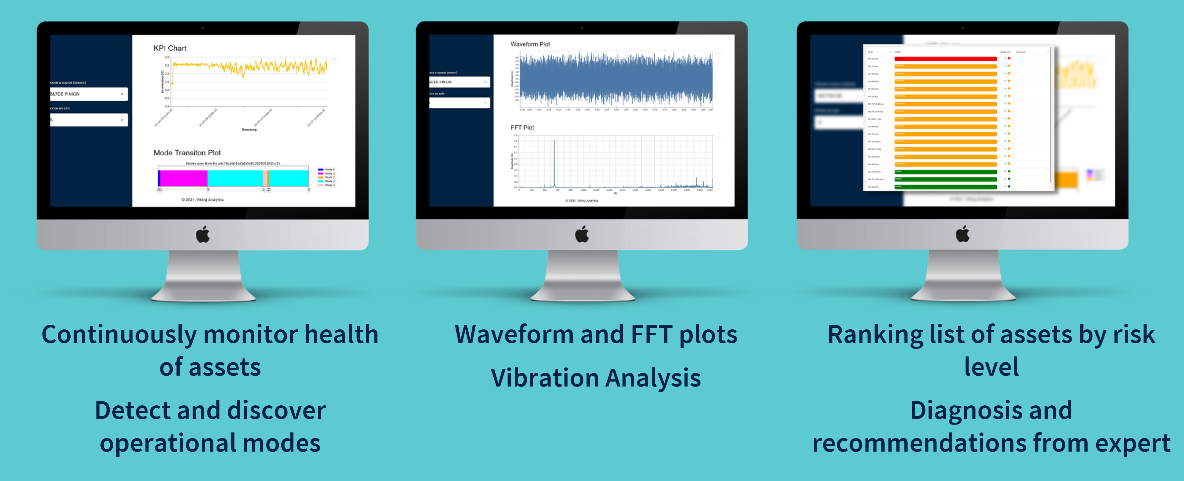
See Global – Condition Monitoring/ Predictive Maintenance (Artificial Intelligence/ Vibraton Data Analytics )

Slide 12
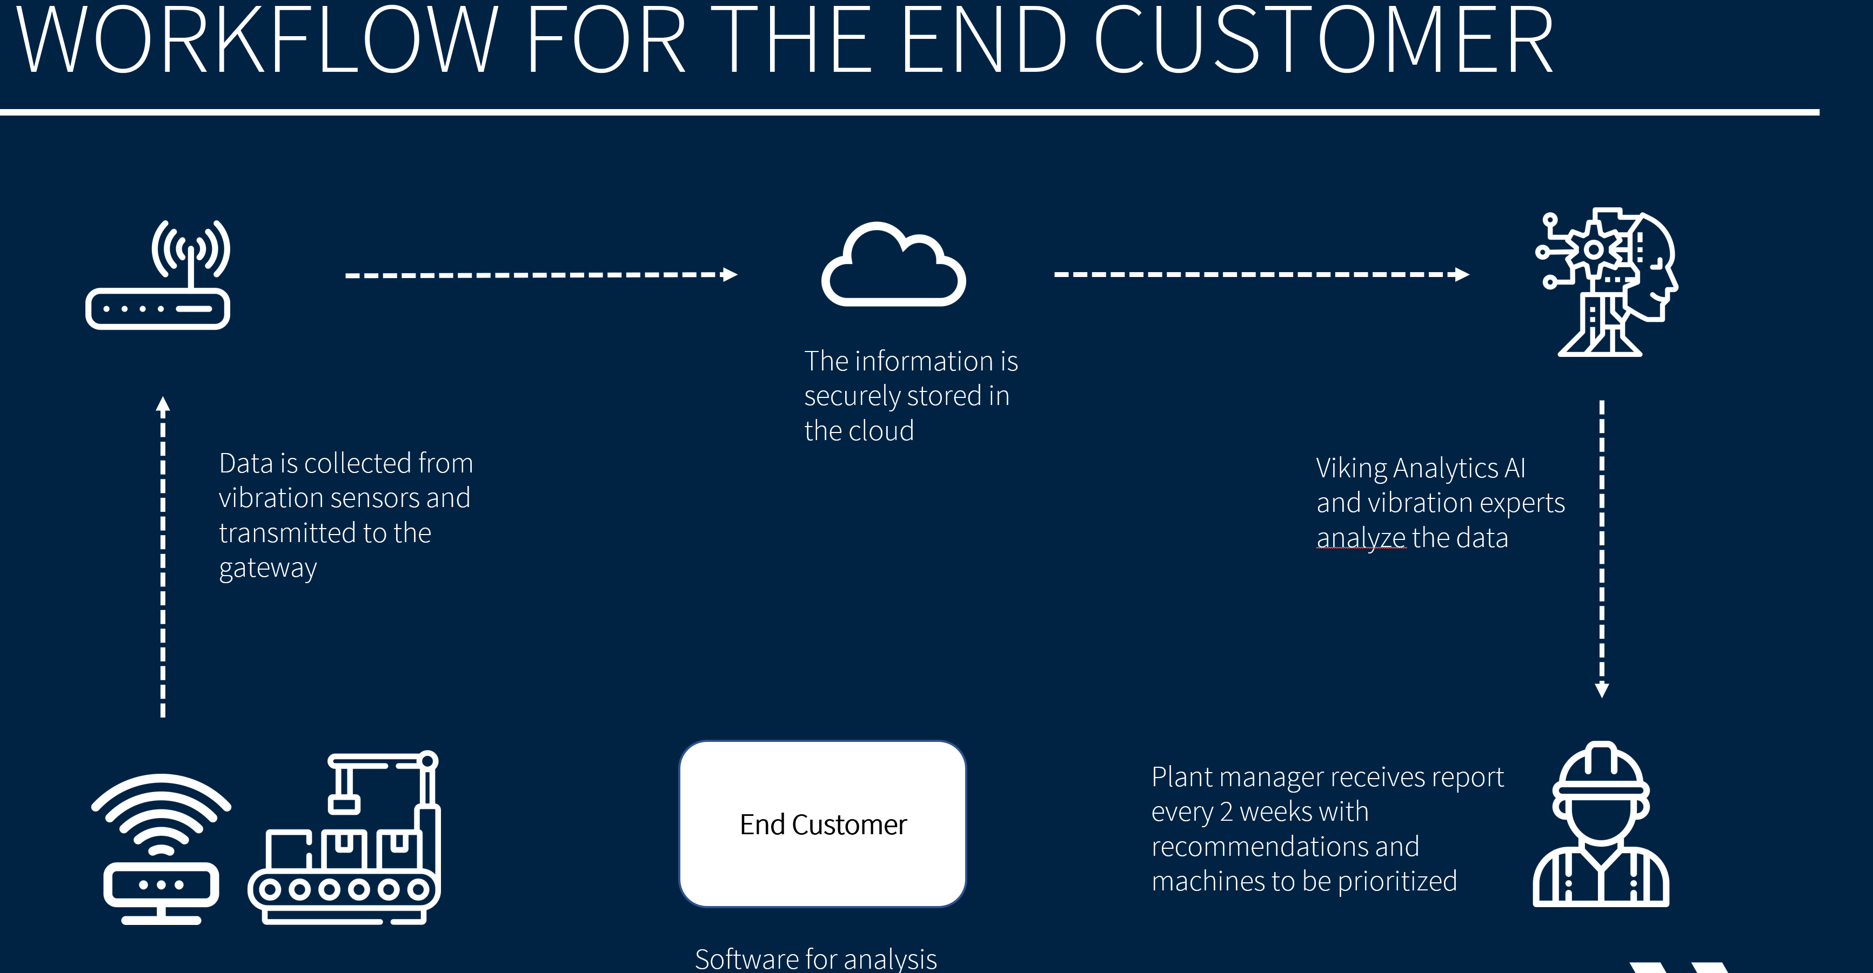
See Global – Condition Monitoring/ Predictive Maintenance (Artificial Intelligence/ Vibraton Data Analytics )

Slide 13
See Global – Condition Monitoring/ Predictive Maintenance (Artificial Intelligence/ Vibraton Data Analytics )
Increases equipment uptime by 10%-20% while reducing overall maintenance costs
Reduce unplanned failure more than 90 %.
Increase Safety for both the machine as well as the Operating personnel .
Cost-efficient way to capture vibration and temperature data continuously for predictive maintenance.
Easy deployment to existing or new machinery. Fully wireless, no need for wiring.
Expert Advise for schedule planned Maintenance for equipment.
Automatic reporting for Asset Availability, Asset utilization , Failure reporting.
Help to improve Asset Excellence

Slide 14
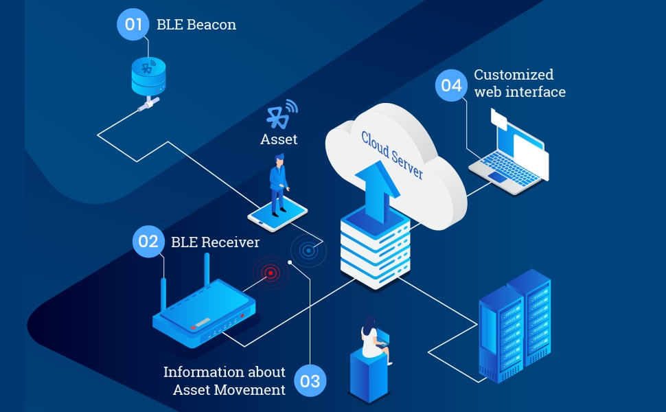

See Global – Asset Monitoring- Track & Trace
Track and Trace and Analytic solutions
Solution for tracking (Presence and position detection)
People,
Assets & Tools,
Vehicles & Yards,
Material Management
Manage asset and tool lifecycle.
Registration, Allocation, Maintenance and Repairs, Decommissioning
Live asset maintenance reporting
Track warranty, repairs and insurance status
Real-time visibility and tracking of assets across the premise

Slide 15
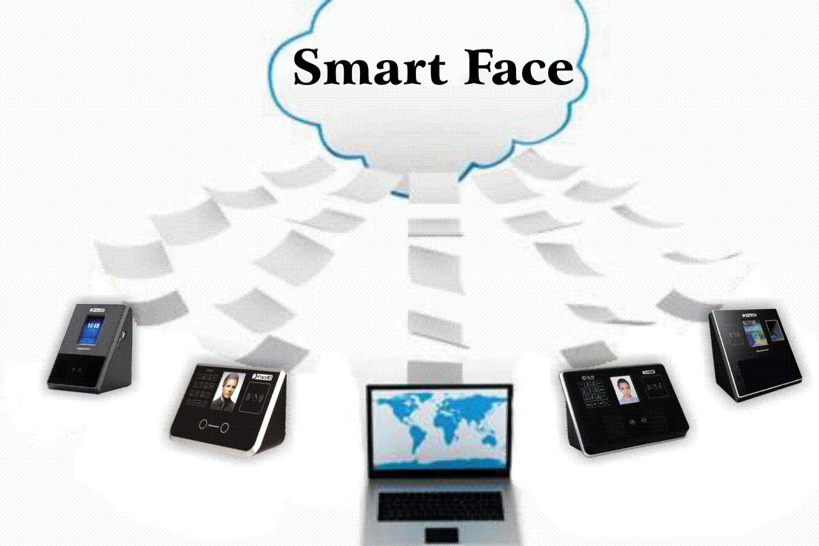
See Global – Asset Monitoring- Video Analytics
WEB BASED communication Software
for Face Based
Attendance Solution

Slide 16
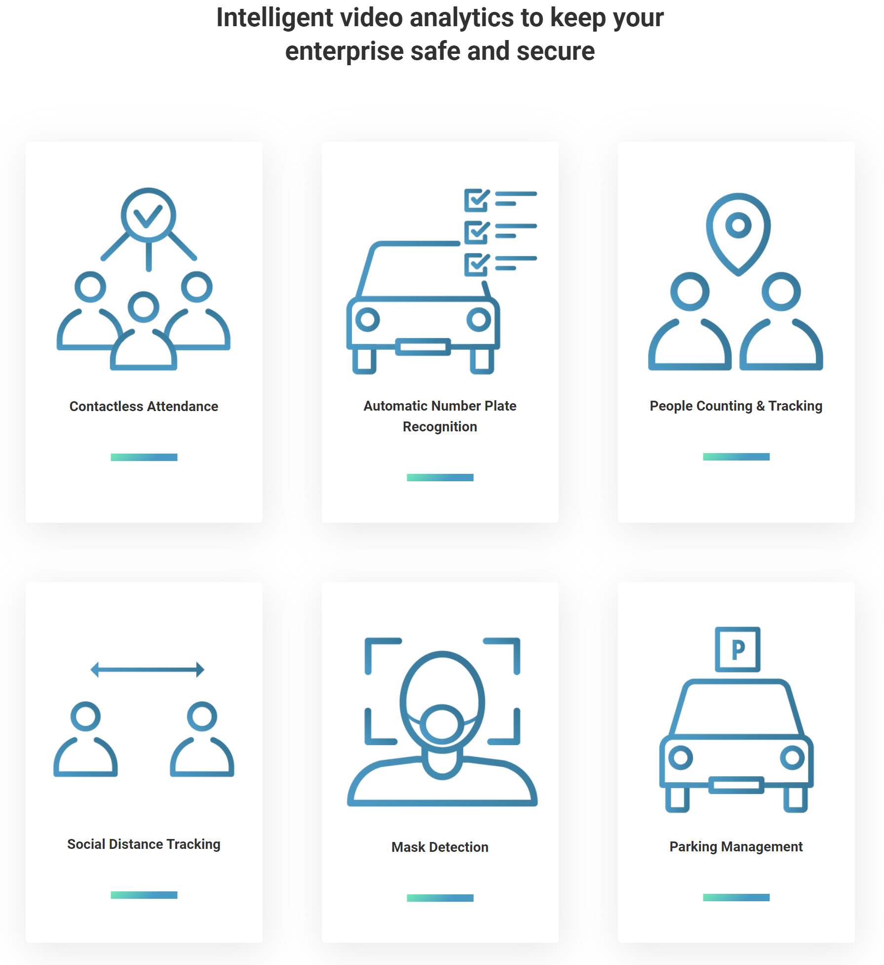
See Global – Asset Monitoring- Video Analytics
Track and Trace and Video Analytic solutions
Face recognition & Attendance
Job Hours calculation
Time on work place
Theft identification
Time period of vehicle and people inside the premises
Unauthorised people movement inside the different zones of premises
Unauthorised vehicular movement inside the premises
Track and raise alarm based on rule

Slide 17
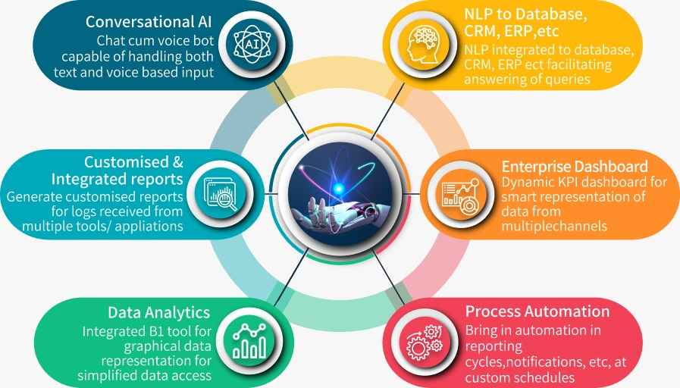
See Global – Technologies Assisto
Model Framework

Slide 18
See Global – Technologies Assisto
Tools - Internal use for organisation
Multi Tool Integrated Dashboard
Unified View for Database Analysis
Asset Tracking, route optimization
Asset health & Life cycle management
Supplies and inventory check
Demand Forecasting
Bring in more efficiency & transparency in SCM
Handling floor queries
Updates and delivery notifications
Operation Automation, including regular admin tasks like invoicing
Improving organization efficiency through process optimization AI tool
Easy access to knowledge and databases
Ease the learning curve for new hire
HR WhatsApp/ Telegram Bot
Attendance on the go
quick insight into Employee leaves, insurance policies & other statutory compliances
Employee efficiency monitoring analysis
Employee Iteration monitoring based on employee behavioral analysis
Easy Cyber Threat Analysis from Multiple Security Device
Customized Reporting

Slide 19
See Global – Technologies Assisto
Tools - External / 3rd party interface for organisation
Analytics report/ dashboard for 3rd party vendors
Multi-vendor coordinated conversation
Product recommendation
Handling customer service efficiently, reducing L1-L2 cost
Providing an interactive platform for vendors and customers
Market content through online channels

Slide 20

See Global – Technologies
Cloud
  AWS, Azure, GCP, DigitalOcean, Heroku
IoT core
  AWS IoT Core , Step functions, Device shadow, Digital Twin, Rule Engine
Embedded
  C/C++, QT, Microcontrollers, Device engineering, Gateway engineering, Communication protocols,
Web Apps Development
  Microservices, Java, .NET Core, Typescript, Python, React, Angular, MEAN, MongoDB, PostgreSQL, ELK
Mobile Apps Development
  Java, Kotlin, Swift, React Native, Ionic, iPhone, Android, Social integrations
CloudOps/DevOps
  IAAC, CI/CD, Jenkins
IT Security:
  Source code scanning (Veracode, Sonarqube)
  Intrusion Detection (Penetration testing, WAF)
  Identification and Authentication (OAUTH 2.0)
  Access Control (RBAC/ABAC)
  Firewall (WAF)
  OWASP
  Public Key
  Infrastructure
  Malicious Code Protection
  Vulnerability Scanners
  Media Sanitizing.
Development process
  Agile, Aha!, JIRA, Confluence, Gliffy, Bitbucket
Automation
  Selenium, Cucumber BDD, Postman

Slide 21
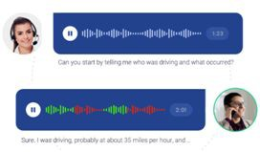
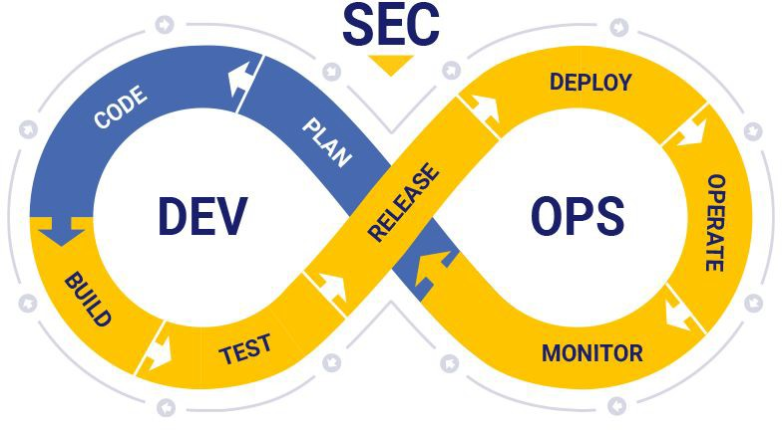
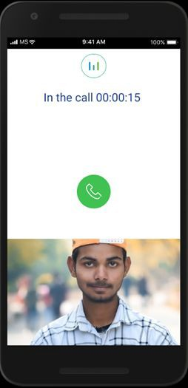
See Global – Technologies
Interview Solution
Secure Cloud and DevOps
Mobile App and Backend Solution
IVR solution development with Twilio and Telnyx
Backend Solution development in serverless environment with AWS, nodejs, lambda, APIGW, Cloudwatch, Jenkins pipeline etc.
Testing and Integration Services
Secure Cloud solution for team
CI/CD pipelines with Jenkins for auto-monitoring
Guidance for initial solution development & hosting
Automated analysis and alarms for issues in logs
Infrastructure as code
Cloud formation scripts for deploying Infra
Secure access over VPN
Security practices (MFA, Secret Manager), Audits
Deployment pipelines on code commit
Automated monitoring
Requirement elicitation & UX Design
Innovative app solution for interview
Instant App – no need to install
E2E Solution architecture, Design, Dev, Test and Release
Backend solution Design & Development
Secure server less and auto-scalable architecture
Best Practices for deployment
Automated monitoring

Slide 22

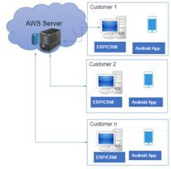

See Global – Technologies
Social App for Music
Auto Service Industry Solution
Payment Solution
Hosting Services on Cloud infrastructure (AWS) for Auto scaling, load balancing, monitoring,
Supporting iOS app for feature enhancement/bug-fixing & maintenance work
Android App development/maintenance
Server side feature
enhancement/bug-fixing, maintenance & testing
Guidance for initial solution development & hosting
Start up building a SAAS solution for ERP/CRM for Automotive Service Industry
Providing Engineering consulting services to the company
Took over of the complete end to end software from the outgoing members
Built the team to own the engineering solution
AWS infrastructure for hosting the backend solution
MongoDB Atlas for hosting DB
Mean stack (NodeJs for backend) and Angular for frontend
Start up building a SAAS solution for ERP/CRM for Automotive Service Industry
App for Phone wallet for payments
Features like Credit money to wallet, wallet to wallet transfer, wallet to account transfer, QR code, Add Cash, Withdraw Cash
App for Indian / African countries
Backend solution on AWS
Admin Web UI for dashboards

Slide 23
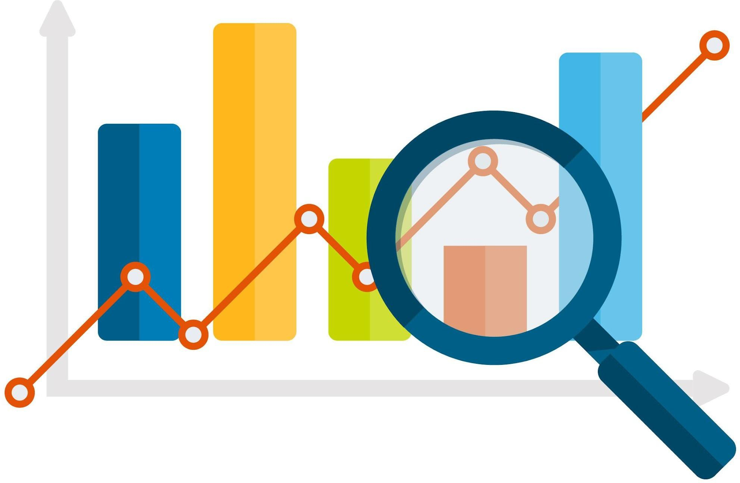
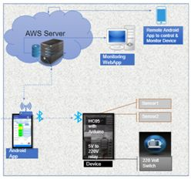
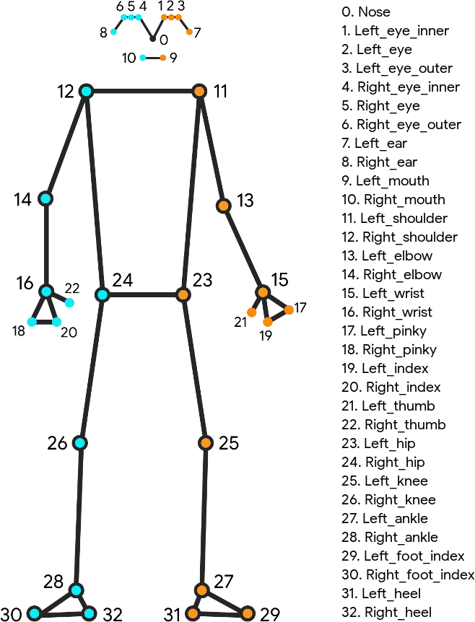
See Global – Technologies
Fitness Analytics Solution
MotoStar
Industrial Productivity Analytics Solution
Analytics solution for body moments tracking and accuracy analysis
Features like ranking of users, reports and dashboards
Analytics engine to analyze the accuracy of actions
App to track the body movements
Integration with the existing developed application
Society Water Management Solution
Device – firmware development
Features include: Start/Stop of Electric Appliance (Motor)
Sensors to detect environmental conditions
Decisions to Start/Stop based on sensor inputs
Timed Start/Stop
Timing Profile to Start/Stop
Mobile App – Android – Monitoring and control
Backend: AWS deployed server for collecting events/stats
AI based solution, which will be used to help industries to identify the gaps/bottlenecks in the manual execution of tasks
Generic solution to identify areas for improvement in the manual execution of assembly lines.
Solution to track the live feed from the workplace
Track the body movements
Analytics engine to analyze the accuracy of users actions
Reports and Dashboards

Slide 24
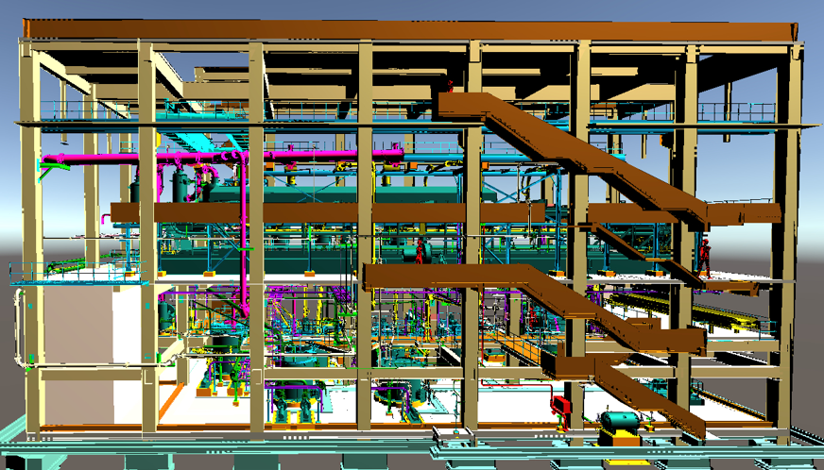
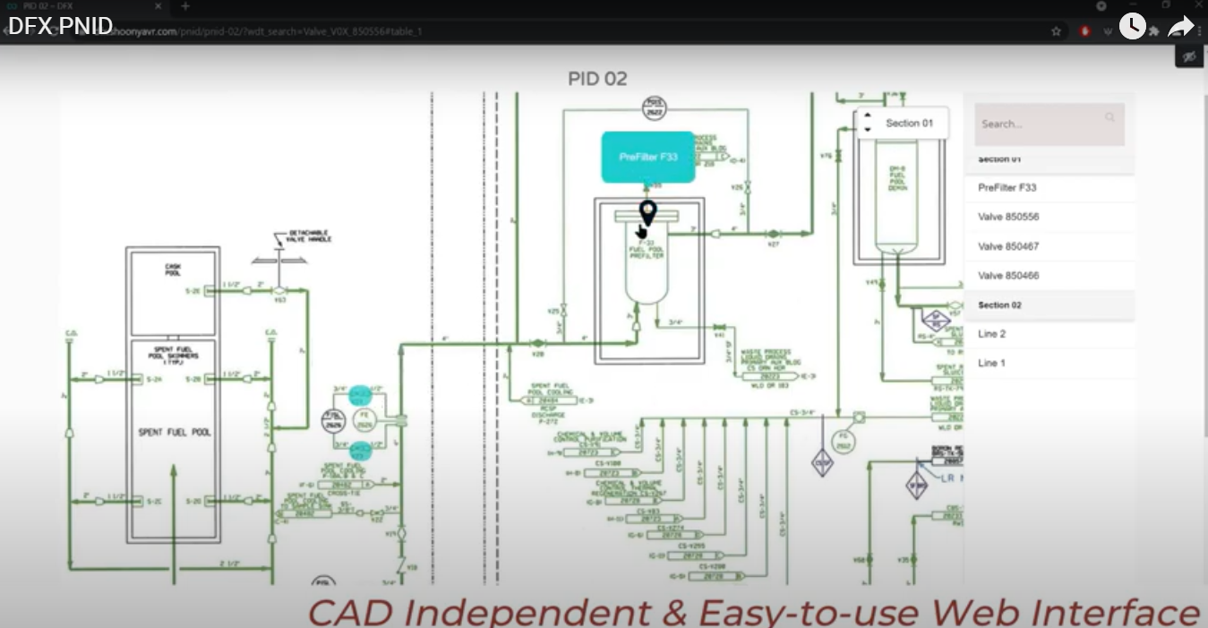
See Global – Technologies
Pilot project – Affordable & Faster validation of Plant Digitalization to check if it works as per your expectation of your Plant Digitalisation Initiative .
Plant 2D Digital Twin
# Recreation of P&ID , SLD , Equipment layout
# Update P&ID , SLD & Plant Layout as per “As-Build”
# Plant 2D digitalization - P&ID , SLD . Plant layout digitalization
3D Pilot Project
Plant 3D Digital Twin
2D Pilot Project
# Plant 2D digitalization
# Point cloud 3D model creation with Laser scan
# Digital P&ID mapping with 3D views

Slide 25


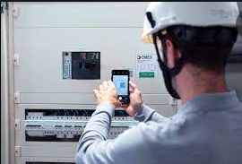
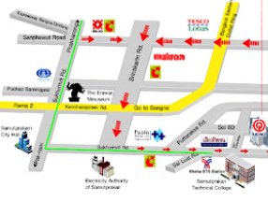
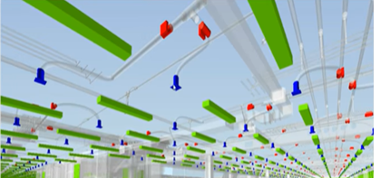


See Global – Technologies
Looking for creating Intelligent & web browser compatible 3D model of your Plant ?
Having difficulties in locating hard copies of all the related documents ?
Laser Scan base to Point cloud to Intelligent Plant 3D model
QR code base identification and related manuals & Datasheets
Difficult to find Equipments and quickly reach to its physical location ?
Manual tracking warranty & Calibration status ?
Walk Way map to Tag Location
Warranty or calibration expiry view

Slide 26
See Global – Technologies
Central Tower Reporting : Aggregated view of multiple plants of Company
Centralized SOPs
Maintenance budget view
O&M SOPs training content base on best practices across different plants .
O&M Optimization
Critical Tag wise maintenance budget Vs Actual tracking .
Minimize downtime to increase the productivity and reduce the demand for more CAPEX for capacity addition
Spares Inventory View
ERP integrated Workflows
Multi Plant level view of Critical and common Spare part inventory
Just in time Engineering spares procurement and accurate budgeting
Warranty View
IOT integrated workflows
One view of All equipment's warranty status (Green – In warranty , Amber – About to Expire , Red – Expired ).
Real time data base optimized Energy uses and operations .

Slide 27
business transformation
Thank you
Contact us:
(India) : marketing@seeglobalinternational.com, Phone No. - +91 98253 18147
www.seeglobalinternational.com

